Slide 1
New Methods in Computational Quantum Field Theory
David A. Kosower Institut de Physique Théorique, CEA–Saclay
Higgs Symposium University of Edinburgh January 9–11, 2013

Slide 2
July 4 is the canonical date for fireworks
July 4, 2012 was the date for a different kind of fireworks, the announcement of the discovery of a New Heavy Boson at CERN
It remains to be confirmed that this boson is the long-awaited Higgs boson of the Standard Model
Will coming years produce new fireworks: dramatic discoveries of resonances or thresholds at the LHC?

Slide 3
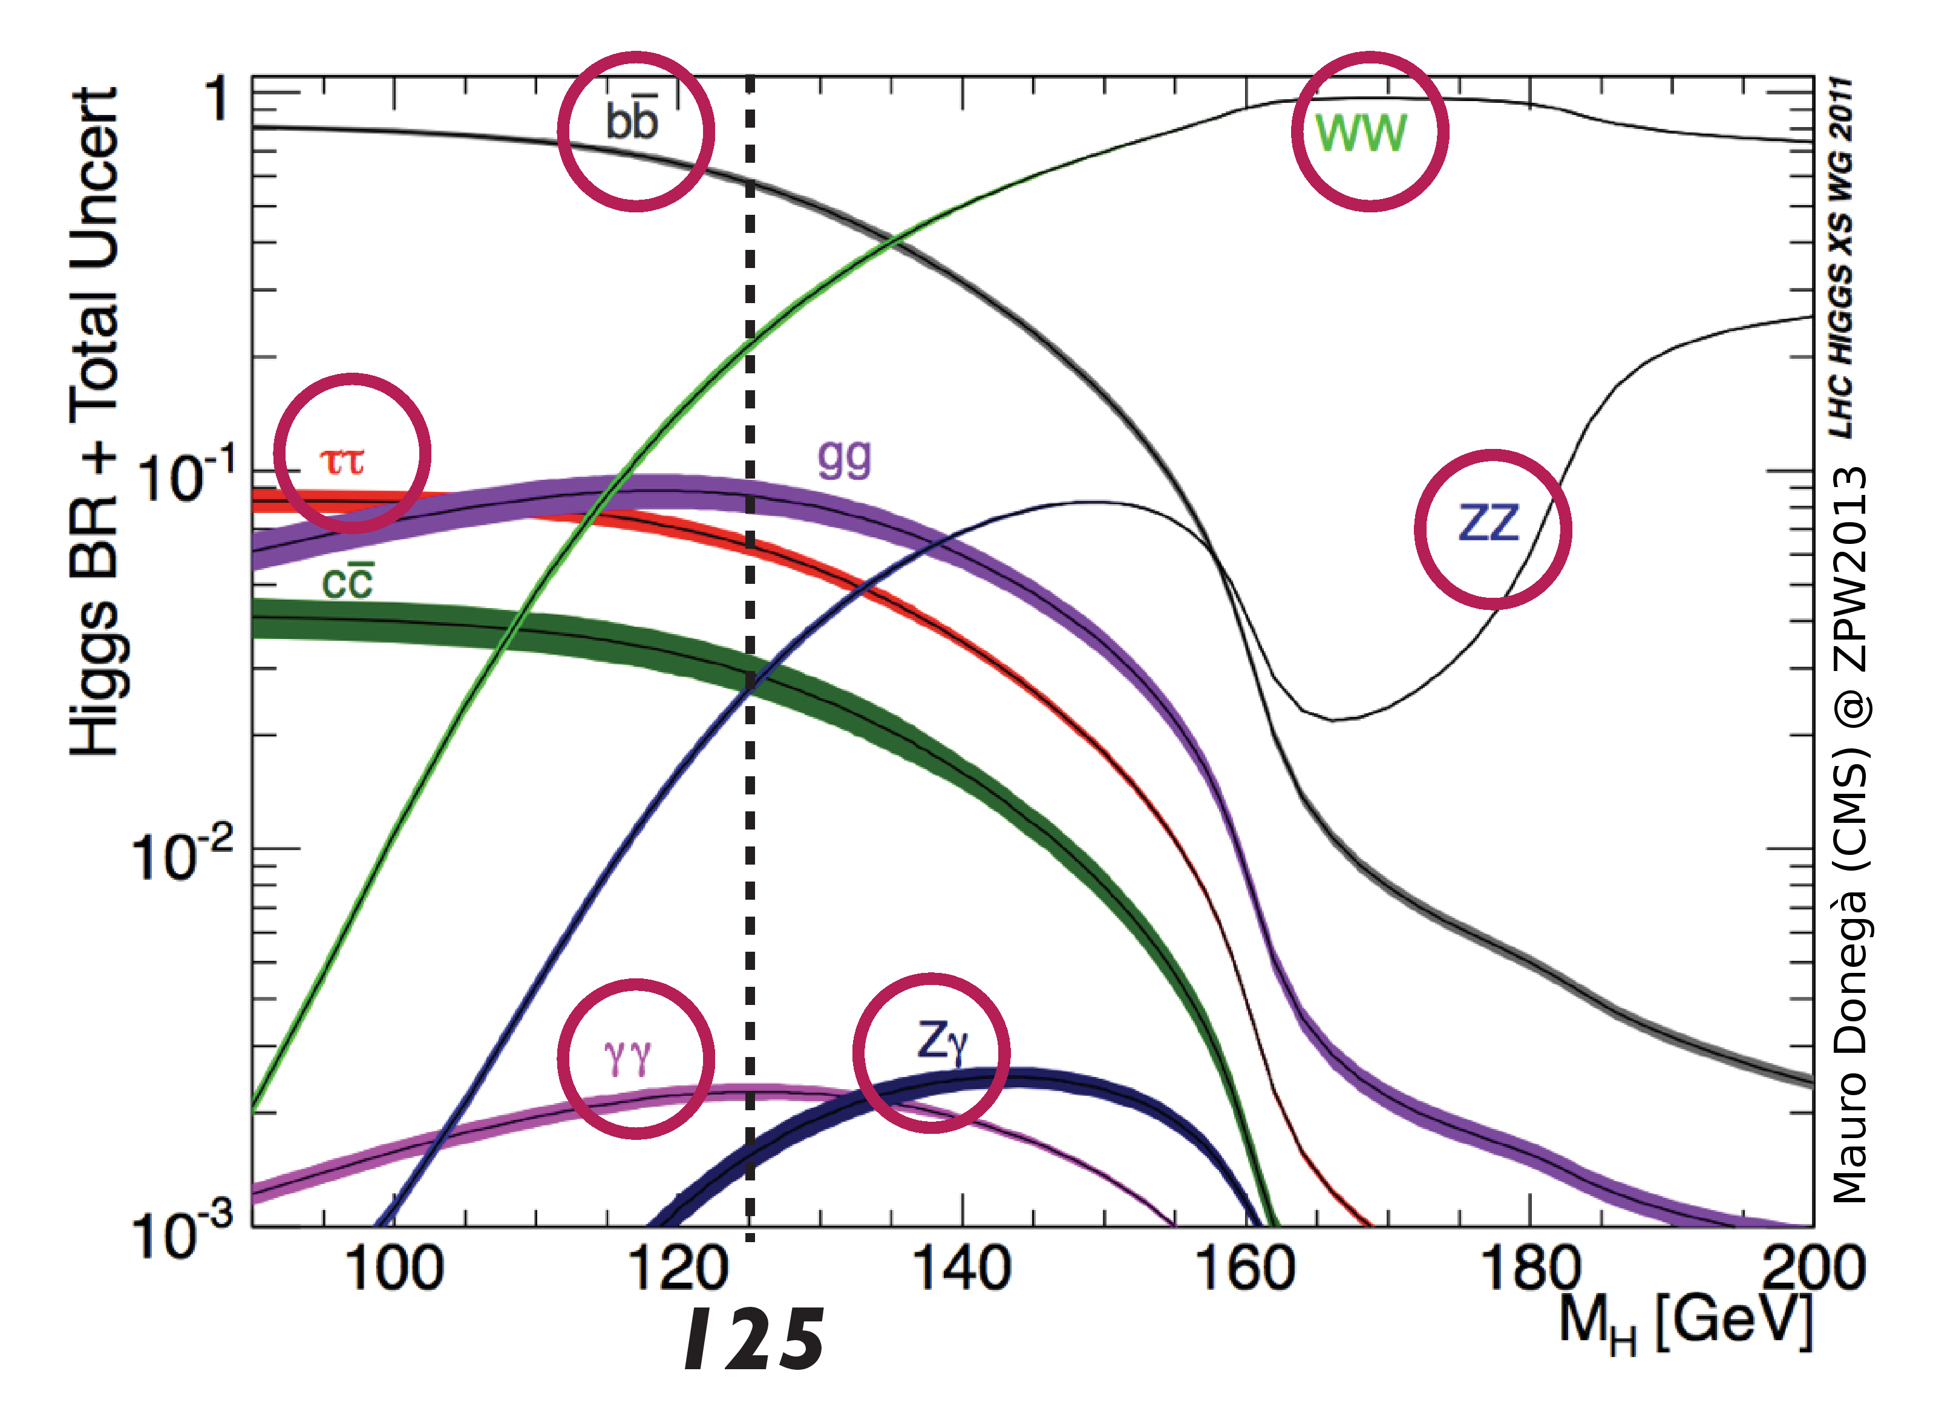
Some Things Are Clear
Precision studies of the new boson (and of the top quark) will play a very important role in probing for physics beyond the Standard Model
Nature has been very kind to experimenters in fixing the mass of the new boson:
there are lots of decay modes to measure
there are a number of production mechanisms to explore
it will be challenging but feasible to make these measurements

Slide 4
Looking Forward
How about measuring isolated ?
Hopeless: swamped by &c
Can try in associated production
But still need to fight the W + 2 jet background

Slide 5
QCD Backgrounds
Challenge to computational theorists: compute them; compute them precisely
Strong coupling is not small: α_{s}(M_{Z}) ≈ 0.12 and running is important
events have high multiplicity of hard clusters (jets)
each jet has a high multiplicity of hadrons
higher-order perturbative corrections are important
Basic leading-order approximation (“tree-level”) isn’t sufficient:
renormalization scale dependence is unphysical but strong
missing sensitivity to jet size & other parameters

Slide 6
Need Next-to-Leading Order

Slide 7
A CMS 10-Jet Event

Slide 9
Amplitudes
Basic building blocks for computing scattering cross sections
Using crossing
Can derive all other physical quantities in gauge theories (e.g. anomalous dimensions) from them
In gravity, they are the only physical observables
MHV

Slide 10
Calculating the Textbook Way
Feynman Diagrams
Over 60 years of successful application in all areas of particle physics and beyond
Heuristic language for scattering processes
Precise rules for computing them to all orders in perturbation theory
Classic successes:
electron g-2 to 1 part in 10¹⁰
discovery of asymptotic freedom

Slide 11
Traditional Approach
Pick a process
Grab a graduate student
Lock him or her in a room
Provide a copy of the relevant Feynman rules, or at least of Peskin & Schroeder’s book
Supply caffeine, a modicum of nourishment, and occasional instructions
Provide a computer, a copy of Mathematica & a C++ compiler

Slide 12
A Difficulty
Huge number of diagrams in calculations of interest — factorial growth
2 → 6 jets: 34300 tree diagrams, ~ 2.5 ∙ 10⁷ terms
~2.9 ∙ 10⁶ 1-loop diagrams, ~ 1.9 ∙ 10¹⁰ terms

Slide 13
Results Are Simple!
Color Decomposition
Parke–Taylor formula for A^{MHV}
Mangano, Parke, & Xu

Slide 14
Spinor Variables
Introduce spinor products
Can be evaluated numerically

Slide 15
Even Simpler in N=4 Supersymmetric Theory
Nair–Parke–Taylor form for MHV-class amplitudes

Slide 16
Answers Are Simple At Loop Level Too
One-loop in N = 4:
All-n QCD amplitudes for MHV configuration on a few Phys Rev D pages

Slide 17
Calculation is a Mess
Vertices and propagators involve gauge-variant off-shell states
Each diagram is not gauge-invariant — huge cancellations of gauge-noninvariant, redundant, parts are to blame (exacerbated by high-rank tensor reductions)

Slide 18
On-Shell Methods
Use only information from physical states
Avoid size explosion of intermediate terms due to unphysical states
Use properties of amplitudes as calculational tools
Factorization → on-shell recursion (Britto, Cachazo, Feng, Witten,…)
Unitarity → unitarity method (Bern, Dixon, Dunbar, DAK,…)
Underlying field theory integral basis
Formalism
Known integral basis:
Unitarity
On-shell Recursion; D-dimensional unitarity via ∫ mass

Slide 19
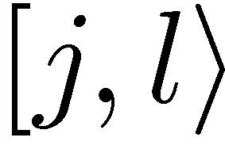
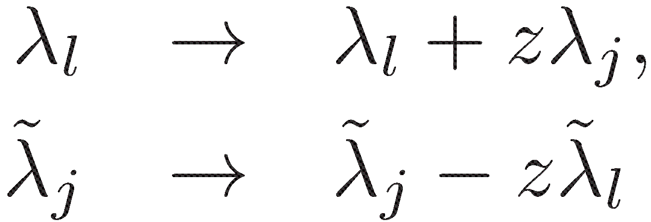
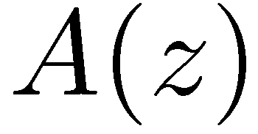
BCFW On-Shell Recursion Relations
Define a shift of spinors by a complex parameter z
which induces a shift of the external momenta
conserves momentum, on-shellness
defines a z-dependent continuation of the amplitude
Assume that as

Slide 20
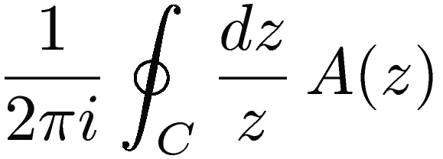
A Contour Integral
Consider the contour integral
Determine A(0) in terms of other residues

Slide 21
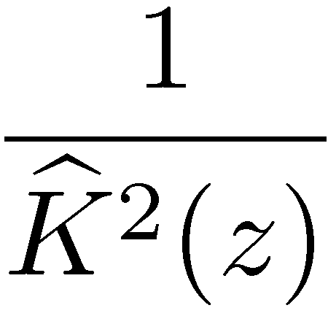
Using Factorization
Other poles in z come from zeros of z-shifted propagator denominators
Splits diagram into two parts with z-dependent momentum flow

Slide 22
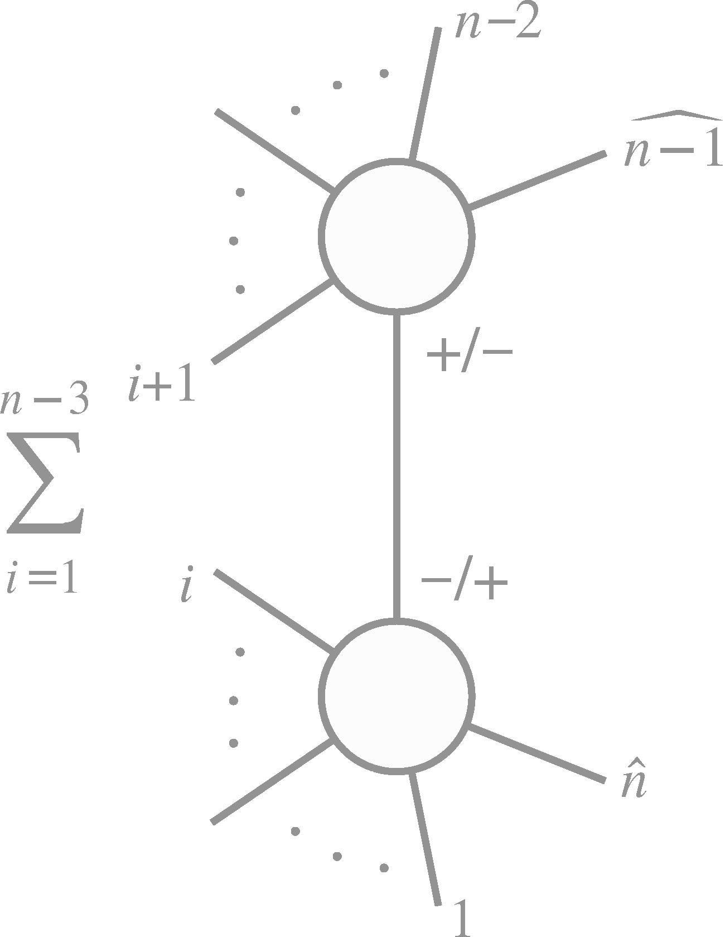
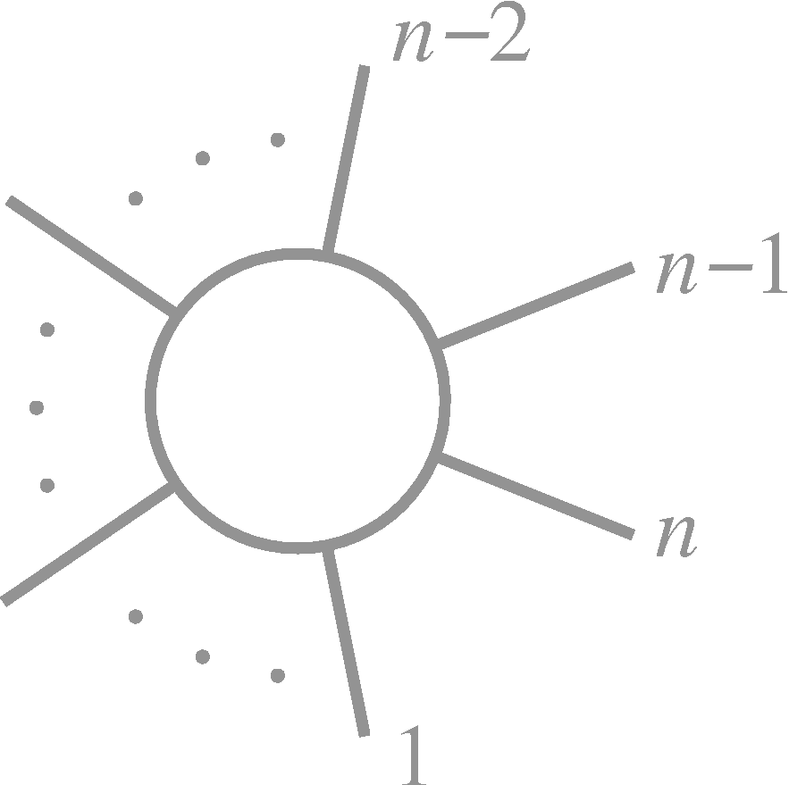
z-dependent amplitude factorizes at poles arising from zeros of
poles from zeros of
Residue
=

Slide 23
Unitarity
Unitarity of the S matrix ⇒ transition matrix T
Simpler because we get higher loop order from lower loop order; one loop from trees
The on-shell method tells us how to get the full transition matrix back

Slide 24
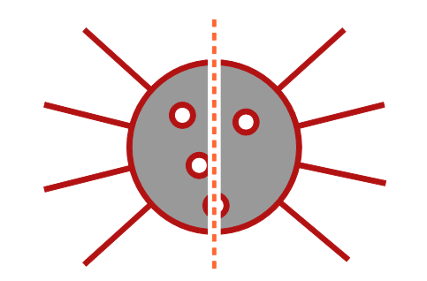
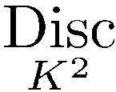
In Feynman Integrals
Cutkosky rules (1960s)
Each cut:

Slide 25
Unitarity-Based Calculations
Bern, Dixon, Dunbar, & DAK
Replace two propagators by on-shell delta functions
⇒ Sum of integrals with coefficients; separate them by algebra

Slide 26
Generalized Unitarity
Can we pick out contributions with more than two propagators?
Yes — cut more lines
Isolates smaller set of integrals: only integrals with propagators corresponding to cuts will show up
Triple cut — no bubbles, one triangle, smaller set of boxes
No unitarity interpretation, but we don’t care

Slide 27
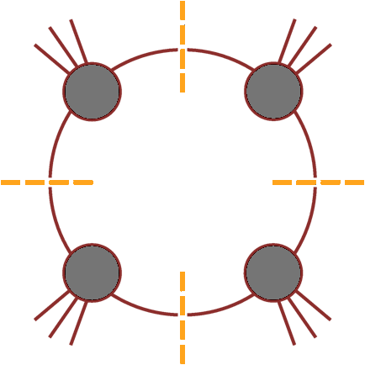
Can we isolate a single integral?
D = 4 → loop momentum has four components
Cut four specified propagators (quadruple cut) would isolate a single box
Need to solve equations putting all four propagators on shell

Slide 28
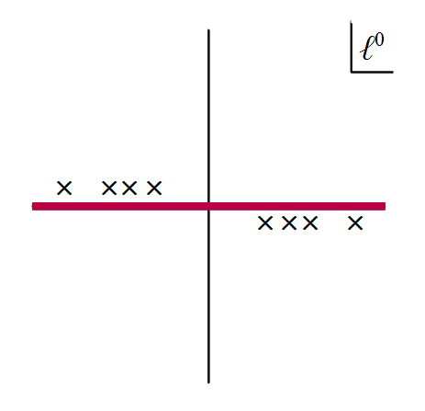
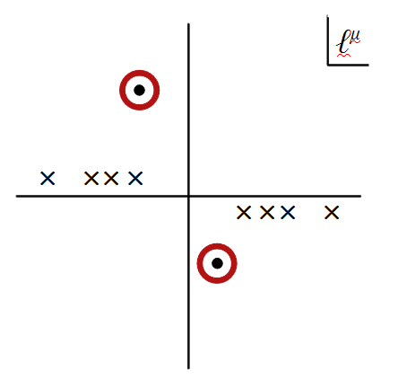
Solutions are complex: delta functions would give zero!
Need to reinterpret delta functions as contour integrals around a global pole
Reinterpret cutting as contour modification

Slide 29
Box Coefficient
A
B
D
C
Applying the quadruple cut (via change of contour) to both sides of our master equation, we derive a simple formula for the box coefficient,
Britto, Cachazo & Feng (2004)
No algebraic reductions needed: suitable for pure numerics
Can obtain direct formulae for other integral coefficients

Slide 30
We can now calculate large classes of amplitudes in gauge theories
Sometimes to infinite numbers of legs
A wealth of data for further study
A foundation for a new subfield
Gauge Theory
String Theory
Amplitudes
Integrability

Slide 31
LHC Physics
N=4 supersymmetric Gauge Theory: solvable?
New representations of Gauge Theory: Grassmannians
make manifest new symmetries
Arkani-Hamed, Bourjaily, Cachazo, Goncharov, Postnikov, & Trnka
Quantum Gravity
Bern, Carrasco, Dixon, Johansson, Roiban; Bern, Davies, Dennen, Huang

Slide 32
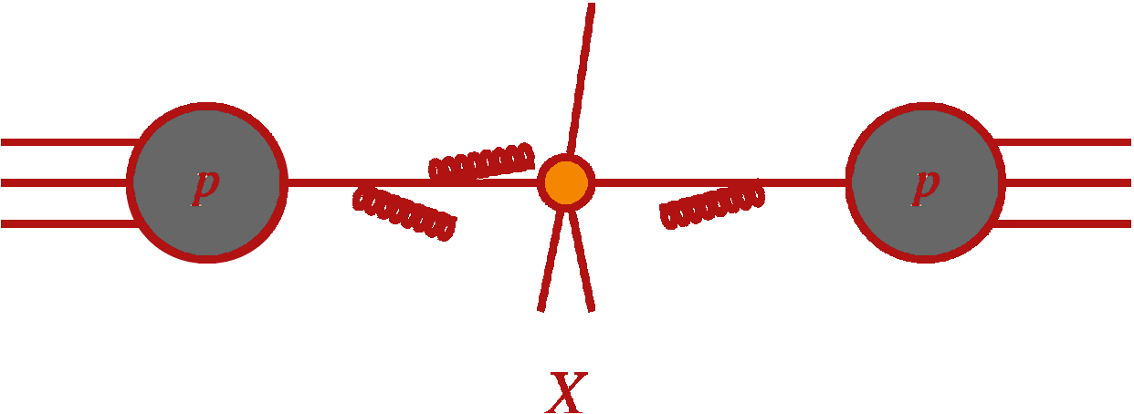
QCD-Improved Parton Model
Notes:
Figure from Del Duca’s talk at Queen Mary

Slide 33
Jet Calculations at NLO
Lots of different ingredients: amplitudes, PDFs
Infrared divergences need to be isolated and canceled ⇒ technology is intricate
Bottleneck until a few years ago: one-loop amplitudes
Numerical implementation of on-shell methods
Automation of processes
NLO Revolution

Slide 34
Collider Physics
Feynman-diagram era: One jet every ~10 years at NLO
~1980: W production ~1990: W+jet production
Transitional era: first matrix elements from unitarity, analytically
~1998: W+2 jet production (MCFM)
Numerical unitarity era: the bottleneck is broken & NLO automated
2009: W+3 jet production
2010: W+4 jet production
2012/3: W+5 jet production

Slide 35
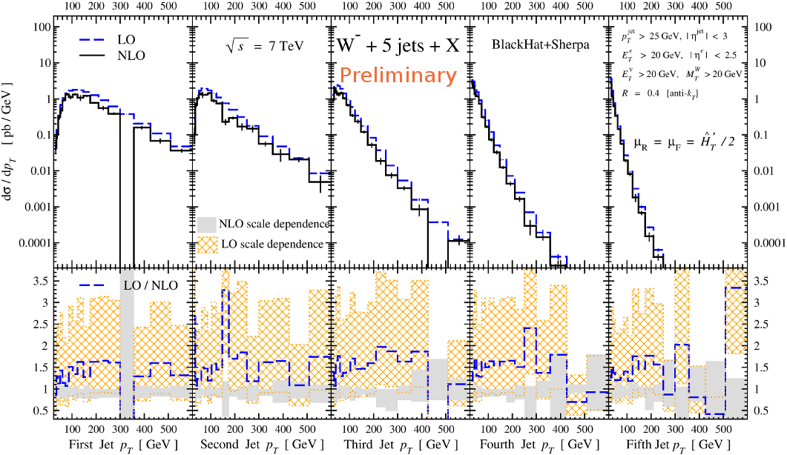
BlackHat: Bern, Dixon, Febres Cordero, Höche, DAK, Ita, Maître, Ozeren

Slide 36
A CMS SUSY Search
Dominant background: Z ( ) + jets
CMS estimated it in 2010 data by measuring γ + jets and translating
Question: what is the theoretical error on the translation?
Using Z + 2,3 jet and γ + 2,3 jet production at NLO, BlackHat was able to assess this at 10%, less than the dominant experimental systematics

Slide 37
N=4 Supersymmetric Gauge Theory
Add four massless Majorana fermions and three massless complex scalars, all in the adjoint
Theory is simpler because it has more symmetry:
supersymmetry
exact conformal symmetry: β(α_{s}) = 0
Strong-coupling limit known (Maldacena duality)
String theory on AdS₅×S⁵
Some quantities computed to all orders in the coupling!
Laboratory for new techniques

Slide 38
Amplitudes to All Orders
BDS exponentiation conjecture for MHV amplitudes
Bern, Dixon, & Smirnov
Exponentiated structure holds for singular terms in all gauge theories — the conjecture is for finite terms too
True for n=4, 5
Because of a new symmetry: dual conformal invariance
Drummond, Henn, Korchemsky, & Sokatchev
Generators are non-local

Slide 39
Wrong Conjectures Can Be More Fruitful than Correct Ones
Conjecture fails for n ≥ 6: there is a remainder R_{n}
Stimulated a great deal of theoretical activity
Numerical calculations using Wilson loops
Drummond, Henn, Korchemsky & Sokatchev; Anastasiou, Brandhub er, Heslop, Khoze, Spence, & Travaglini
Analytic approximations to high loop order
Bartels, Lipatov, Sabio Vera; Dixon, Duhr, Pennington; Gaiotto, Maldacena, Sever, & Viiera
Progress towards all-orders forms using ideas from integrability
Caron-Huot & He; Sever, Vieira, & Wang
Novel ideas about simplifying analytic expressions
Goncharov, Spradlin, Vergu, & Volovich; Duhr, Gangl, & Rhodes
With applications to Higgs boson amplitudes in QCD
Duhr

Slide 40
Quantum Gravity
How many candidate theories of quantum gravity are there?
Superstring theory is one; are there others?
Loop integrals may have UV divergences: no surprise, we’re probing the theory at infinitely short distance
Gauge theories are renormalizable: UV divergences that arise in loop integrals can be absorbed into a finite number of couplings
Only need a finite number of experiments to predict all others

Slide 41
Gravity can only be predictive if it is finite
Pure Einstein gravity is finite at one loop
But not at two (Marcus & Sagnotti; van de Ven)
Need new physics to make theory consistent
Could that be supersymmetry?

Slide 42
Intellectual screening
Cannot prove absence of counterterm
Counterterm exists
Theory diverges

Slide 43
Ultimate test of ideas in science is experiment
It may be a while before we do experiments in quantum gravity
Ultimate test of finiteness in quantum gravity: calculate!

Slide 44
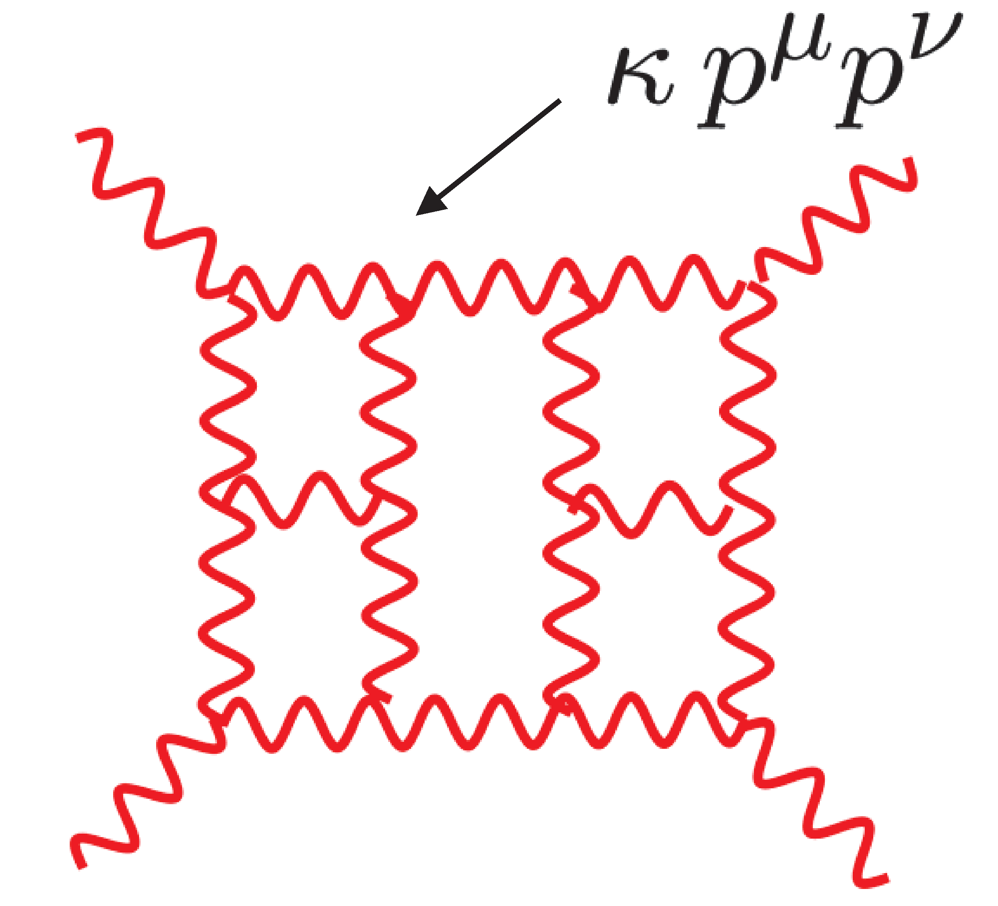
With Feynman diagrams, it was just too hard
Three-vertex is 100 times worse than gauge theory
There are higher-order vertices
Tensor powers go twice as high
With on-shell methods (unitarity) and additional important insights, it became possible
Surprises:
N=8 supergravity is finite in D=4 at three loops
N=8 supergravity is finite in D=4 at four loops
N=4 supergravity is finite in D=4 at three loops
Bern, Carrasco, Dixon, Johansson, Roiban Bern, Davies, Dennen, Huang
10³⁰ terms

Slide 45
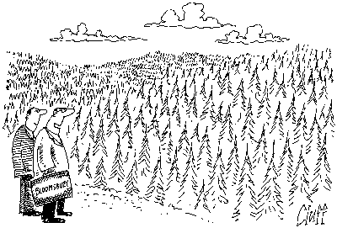
"One day, all of these will be papers about the Higgs boson."

